Slide 1
Sorting By Selection
Problem: Given a randomly ordered set of n integers, sort them into ASCENDING order using the SELECTION SORT.
Analysis:
Unsorted Array
Sorted Array
Comparing the sorted and unsorted arrays, we see that one way to start off the sorting process would be to perform the following
20 | 35 | 18 | 8 | 14 | 41 | 3 | 39
3 | 8 | 14 | 18 | 20 | 35 | 39 | 41
Selection Sort Lecture

Slide 2
1. Find (SELECT) the smallest element in the unsorted array.
2 Place the smallest element in position values[0].
i.e.
indexOfMin = 0;
for (int index = indexOfMin+1; index < endIndex; index++)
if (values[index] < values[indexOfMin] )
indexOfMin = index;
20 | 35 | 18 | 8 | 14 | 41 | 3 | 39
Selection Sort Lecture

Slide 3
We now know the position of the minimum value . In order then to place the minimum in values[0], of course we must save the value 20 and place it somewhere else – obviously the easiest place to put it, is where 3 was – i.e. in values[6] – i.e. SWAP NUMBERS
The code on the previous slide can be “wrapped up” in a function that can be reused throughout the Selection sort process.
template <class ItemType>
int minIndex(ItemType values[ ], int startIndex, int endIndex)
{
int indexOfMin = startIndex;
for (int index = indexOfMin+1; index <= endIndex; index++)
{ if (values[index] < values[indexOfMin] )
indexOfMin = index;
}
return indexOfMin;
}
Selection Sort Lecture

Slide 4
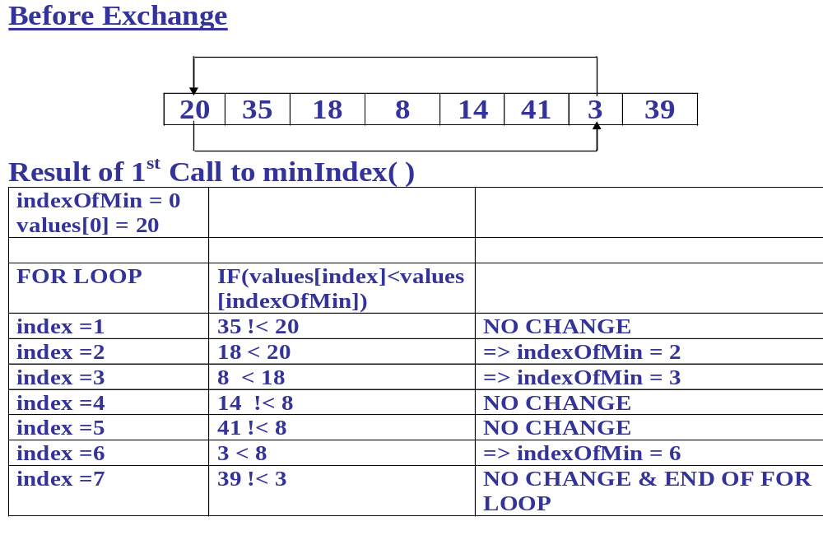
Selection Sort Lecture

Slide 5
After Exchange
3 | 35 | 18 | 8 | 14 | 41 | 20 | 39
Unsorted Part of Array
Sorted Part of Array
The same strategy can be now used to find and place the second smallest element in it’s proper order.
Selection Sort Lecture

Slide 6
The swapping of the numbers and the finding of the minimum values can be incorporated into a separate function
template <class ItemType>
void SelectionSort(ItemType values[ ], int numValues)
{
int endIndex = numValues -1 ;
for (int current = 0; current < endIndex; current++)
{
Swap(values[current], values[minIndex(values, current, endIndex)]);
}
}
Selection Sort Lecture

Slide 7
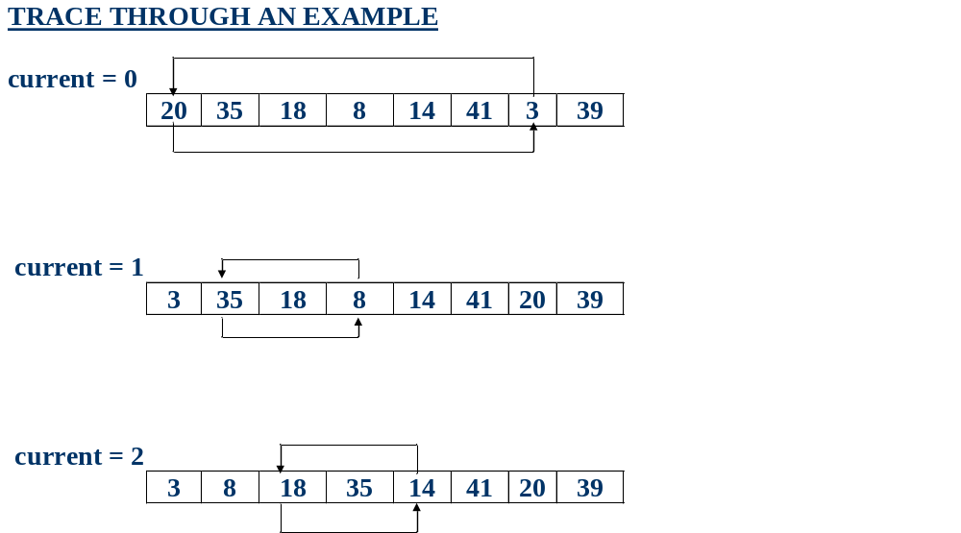
Selection Sort Lecture

Slide 8
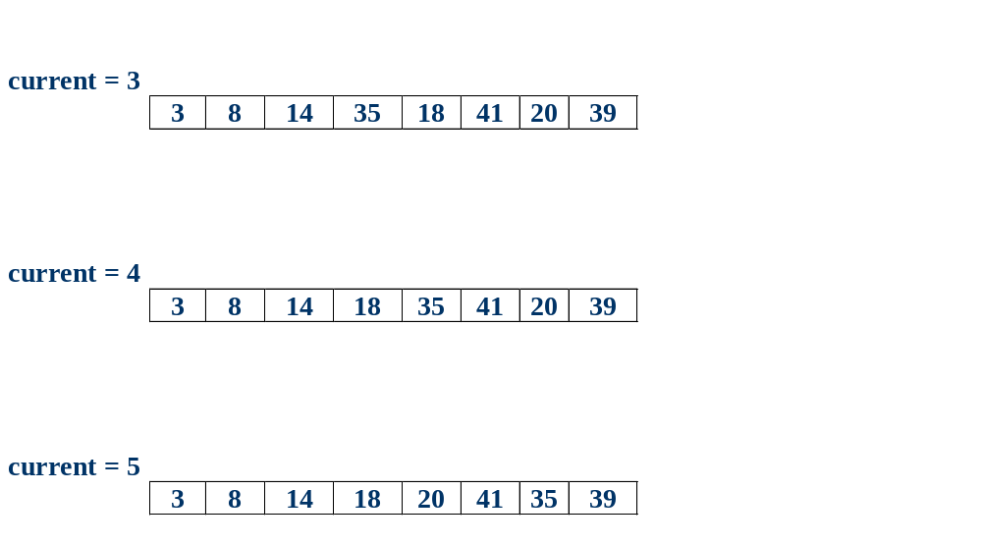
Selection Sort Lecture

Slide 9
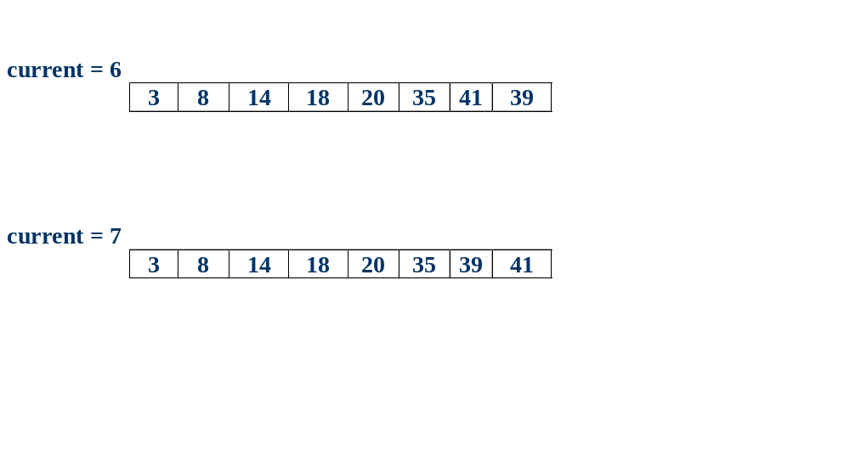
Selection Sort Lecture

Slide 10
Class Exercise
The original numbers are:-
46 | 30 | 82 | 90 | 56 | 17 | 95 | 15 | 48 | 26
Use the Selection Sort Algorithm to Sort the above – Do a trace of this exercise
The sorted numbers are:-
15 | 17 | 26 | 30 | 46 | 48 | 56 | 82 | 90 | 95
Selection Sort Lecture

Slide 11
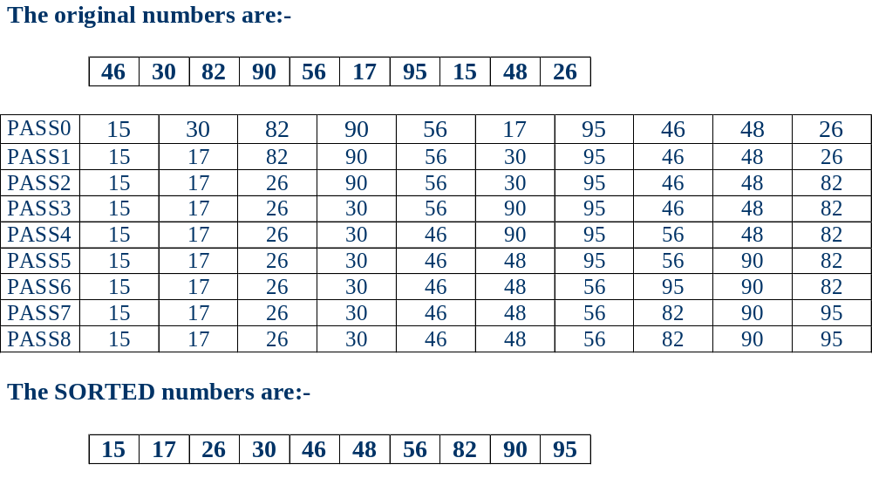
Selection Sort Lecture

Slide 12
Complete Source Code
template <class ItemType>
int minIndex(ItemType values[ ], int startIndex, int endIndex)
{
int indexOfMin = startIndex;
for (int index = indexOfMin+1; index <= endIndex; index++)
{ if (values[index] < values[indexOfMin] )
indexOfMin = index;
}
return indexOfMin;
}
=========================================================
template <class ItemType>
void SelectionSort(ItemType values[ ], int numValues)
{
int endIndex = numValues -1 ;
for (int current = 0; current < endIndex; current++)
{
Swap(values[current], values[minIndex(values, current, endIndex)]);
}
}
Selection Sort Lecture

